Slide 1
LONG RUN COST CONCEPTS
NAPINDER KAUR
Assistant Professor

Slide 2
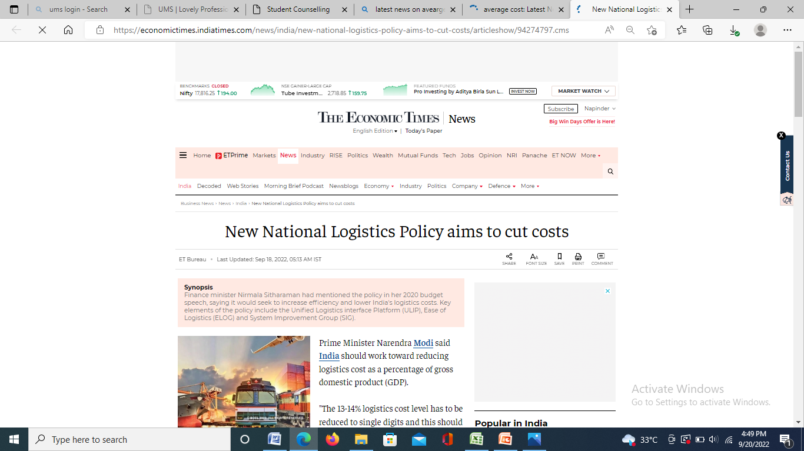
WHAT’S IN THE NEWS?

Slide 3
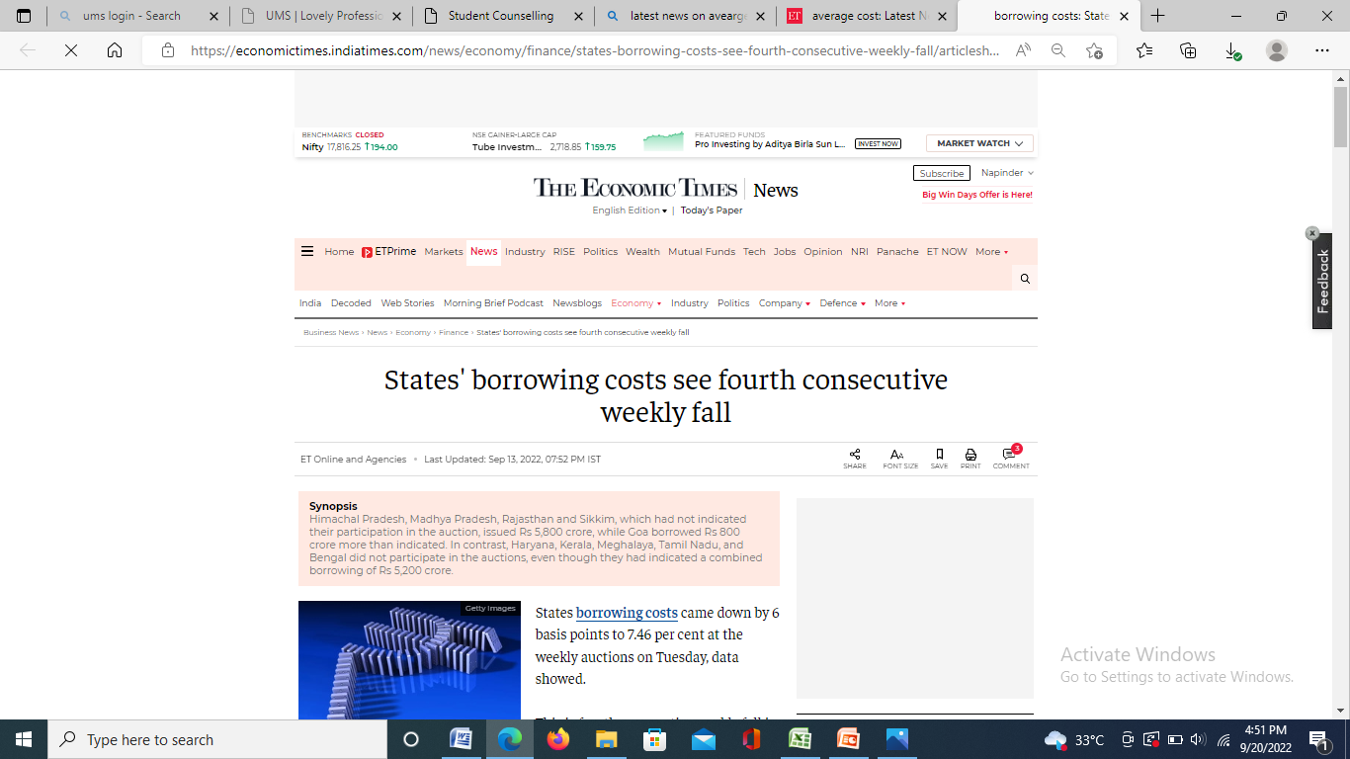

Slide 4
LEARNING OUTCOMES
After the lecture, you will be able to
Analyze the importance of matching costs with relevant time frames
Understanding of estimation of long run cost functions.

Slide 5
LONG RUN AVERAGE COST
Envelope curve
Planning curve

Slide 6
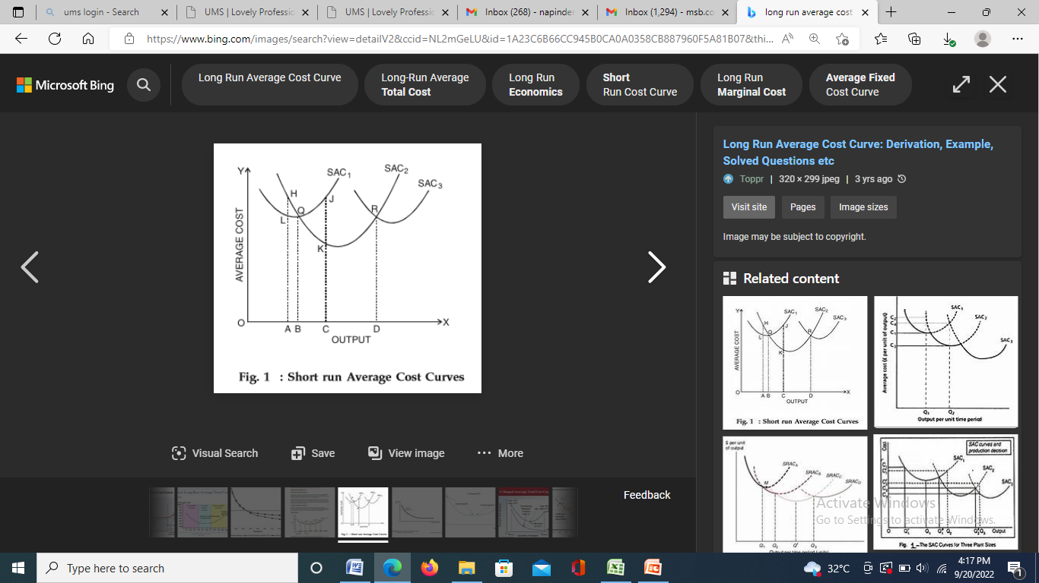
AVERAGE COST

Slide 7
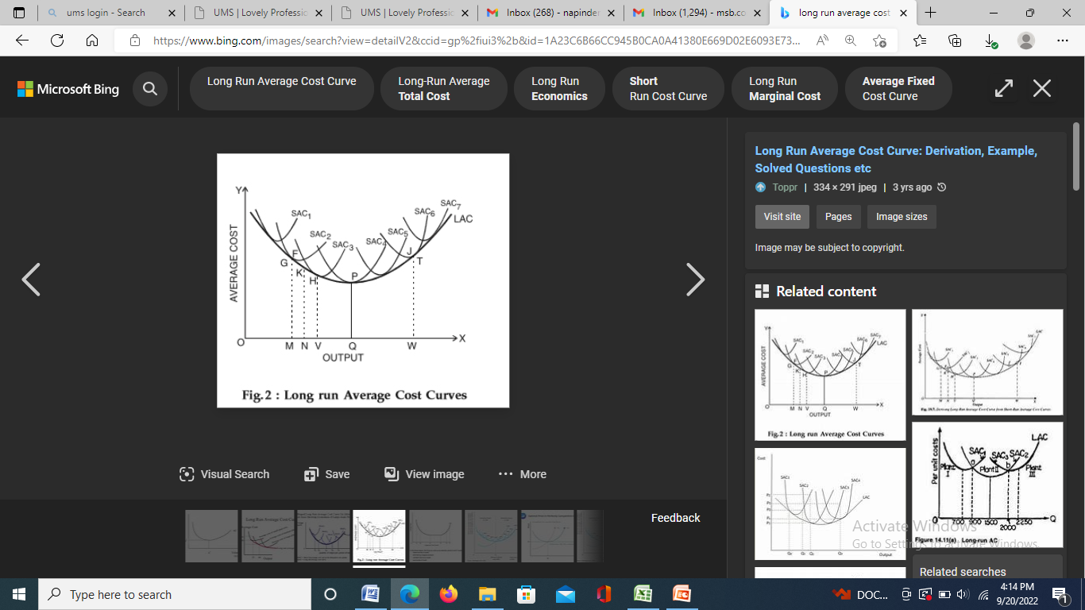
AVERAGE COST

Slide 8
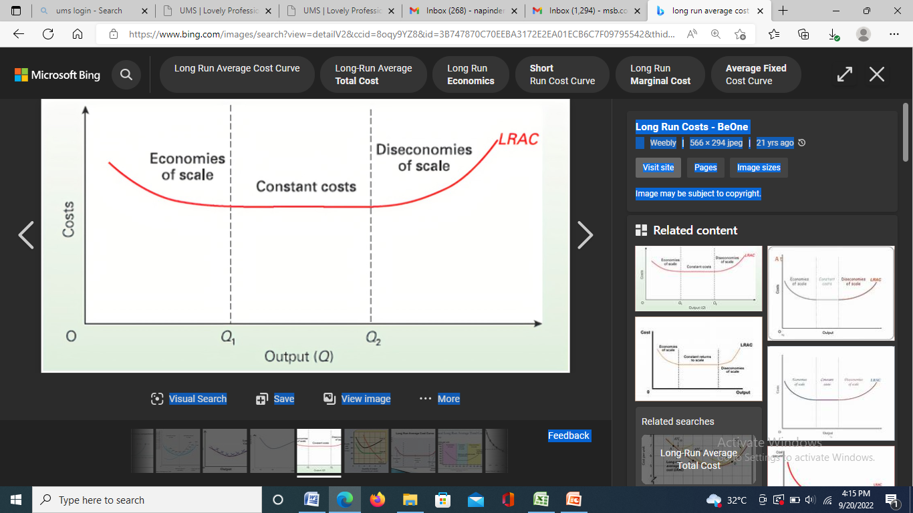
SHAPE OF AVERAGE COST

Slide 9
REASONS FOR U-SHAPED AVERAGE COST CURVE
Economies of scale
Economies of scope
Diseconomies of scale

Slide 10
INTERNAL ECONOMIES
Specialisation
Greater efficiency of machines
Managerial economies
Financial economies
Production in stages

Slide 11
EXTERNAL ECONOMIES
Technological advancement
Easier access to cheaper raw material
Financial institutions in proximity
Pool of skilled workers

Slide 12
DISECONOMIES OF SCALE
Decrease in productivity when there are equal increases in all inputs, assuming that no input is fixed.

Slide 13
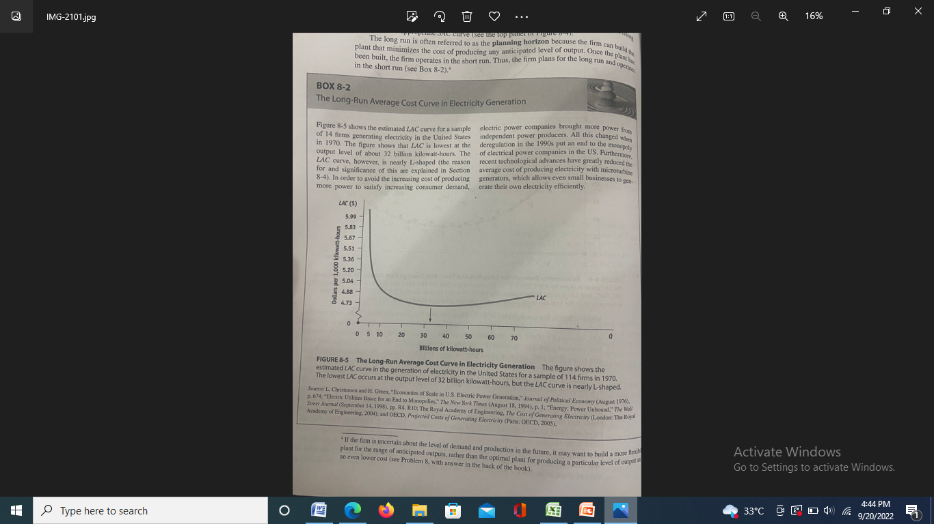
CASE ANALYSIS

Slide 14
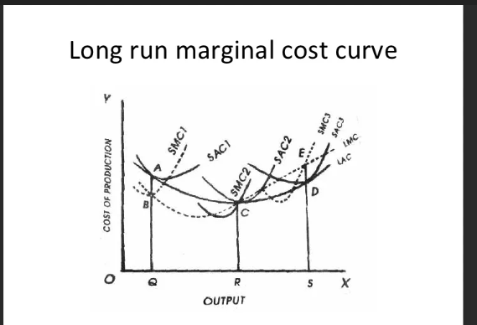
LONG RUN MARGINAL CURVE

Slide 15
COSTS OF MULTI PRODUCT FIRM
TC = TFC + C1Q1 + C2Q2

Slide 16
COST PF JOINT PRODUCTS
Physical measure
Sales value at split off

